Slide 1

NYC High School Educational Outcomes
By: Austin Jia

Slide 2
Motivation
2016 report from Institute for State and Local Governance:
“These scores suggest that NYC continues to be characterized by vast inequalities, and that when looking at the city as a whole, little has changed. Generally speaking this score means that overall, the disadvantaged groups represented here are almost twice as likely as those not disadvantaged to experience negative outcomes in fundamental areas of life, as measured by the Equality Indicators.

Slide 3
Motivation
Bronx High School of Science
August Martin High School in Queens
Droves of students to Ivy League
Hundreds of empty seats

Slide 4
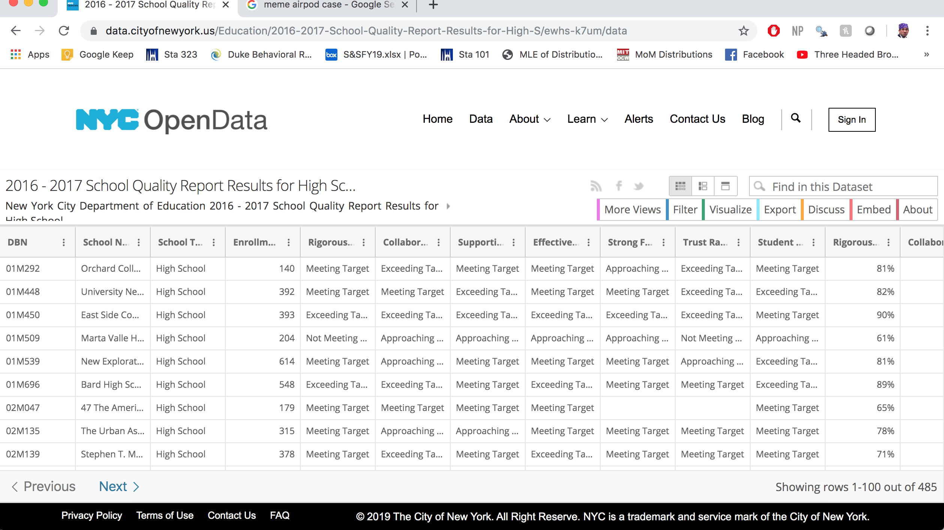
Data
NYC Open Data: https://data.cityofnewyork.us/Education/2016-2017-School-Quality-Report-Results-for-High-S/ewhs-k7um/data
485 Schools

Slide 5
Data description
Response variable
Predictors
Student Achievement Rating
Race – White, Black, Asian, Hispanic
Student Composition – Economic Need Index, Disabilities, ESL, Undercredited
School-specific metrics: attendance rates, faculty experience
Subjective Ratings – Supportive Environment, Trust, Teacher/Curriculum Quality

Slide 6

Data Wrangling

Slide 7
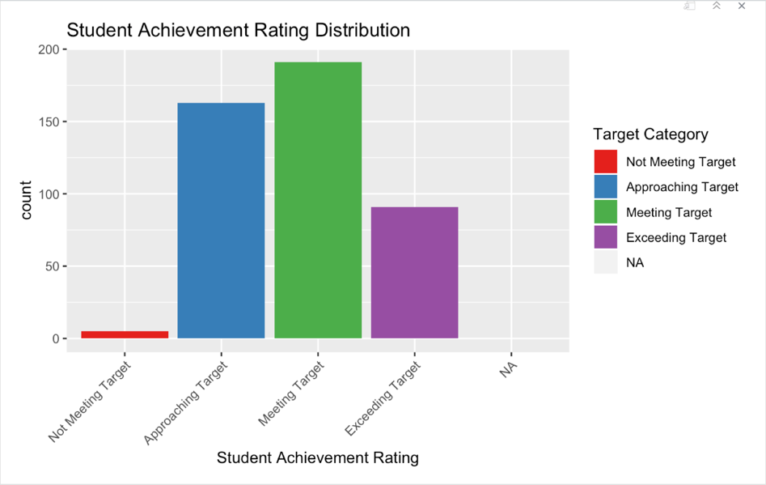
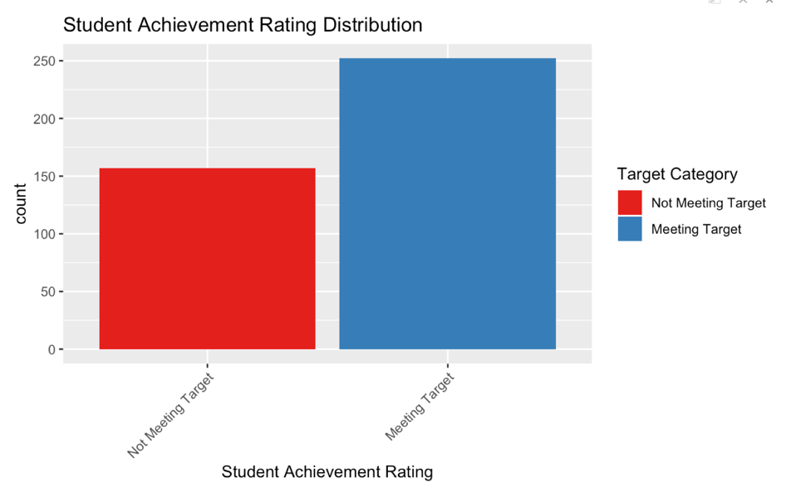
1. Dealing w/ Response Variable
Only 39 occurrences of Not Meeting Target
Not ideal for classification problem b/c not enough occurrences per covariate combination
More meaningful for policymakers to have binary cutoff for budget allocation purposes

Slide 8
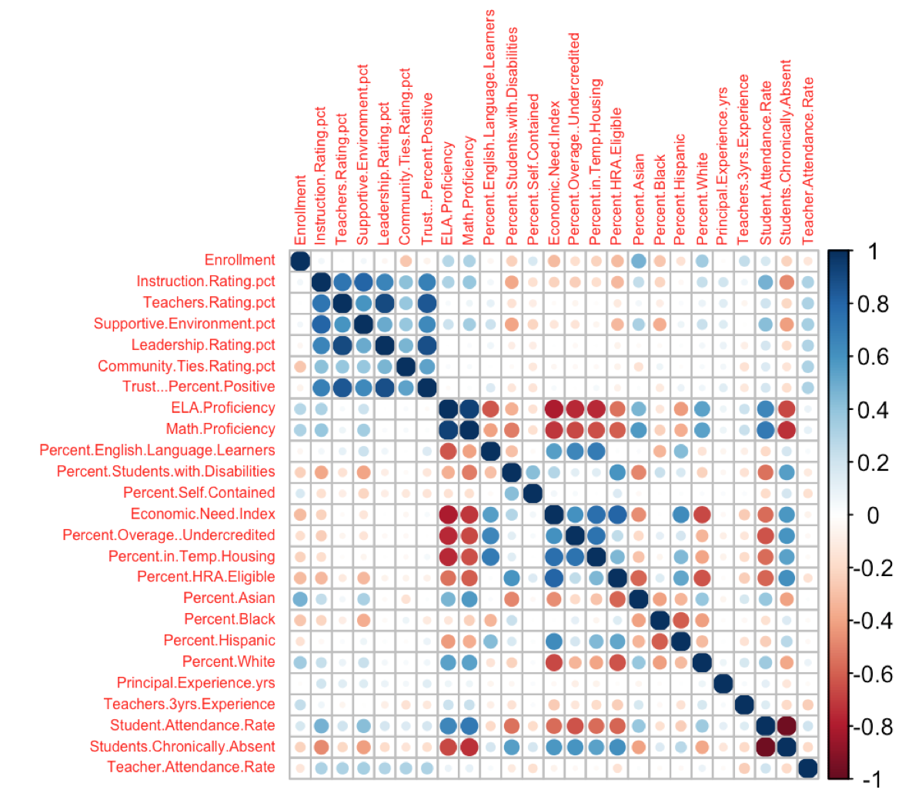
2. Collinear Predictors
Pockets of almost perfect collinearity especially
Quality ratings
Racial breakdown
Faculty attendance rate
Suggested need for regularization models later

Slide 9
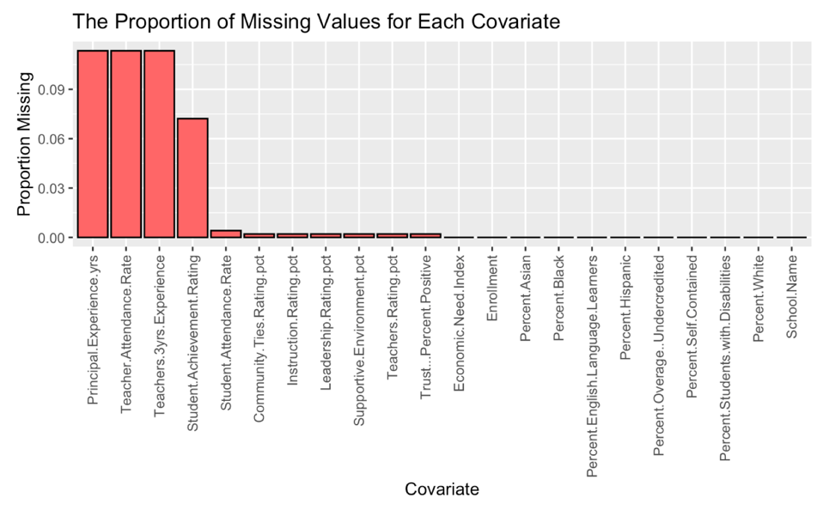
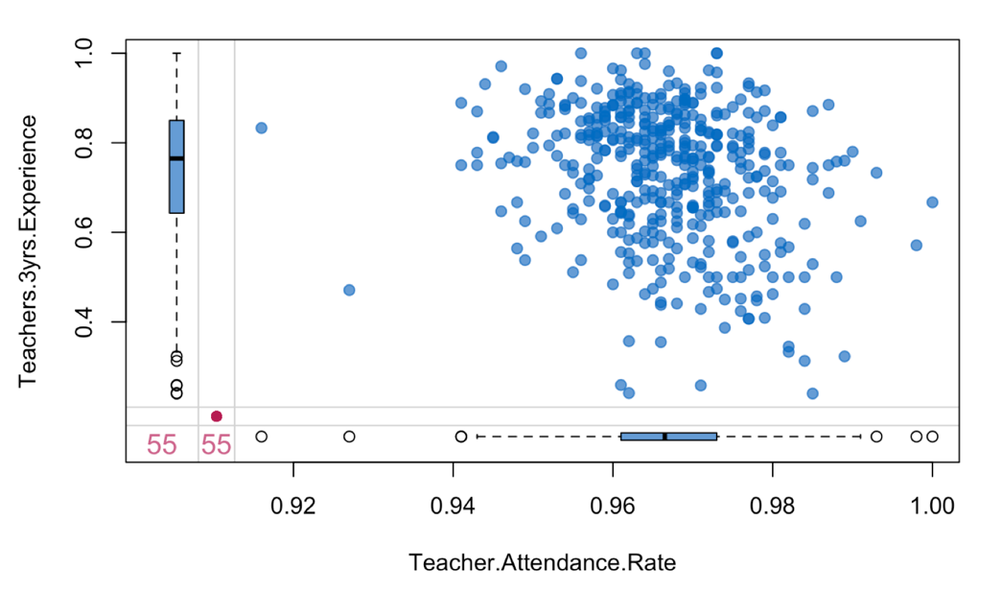
3. Missing Data
Only 84% are complete cases
Can’t afford complete case analysis with only 485 schools
Clear missingness dependence
MICE with 4 imputed datasets

Slide 10

Exploratory data analysis

Slide 11
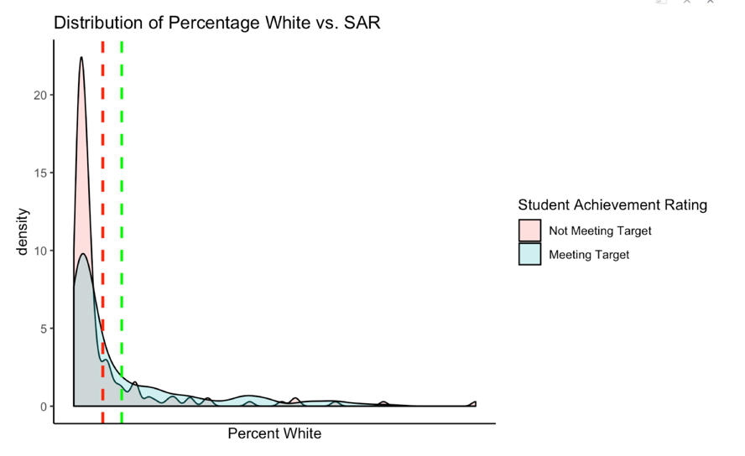
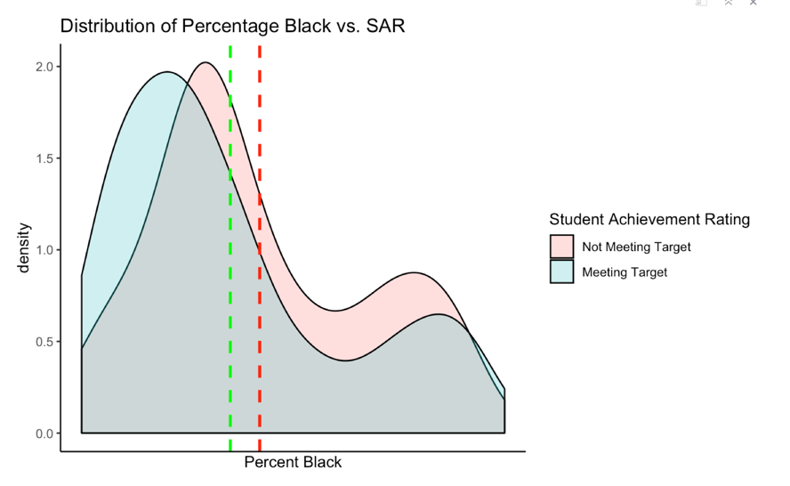
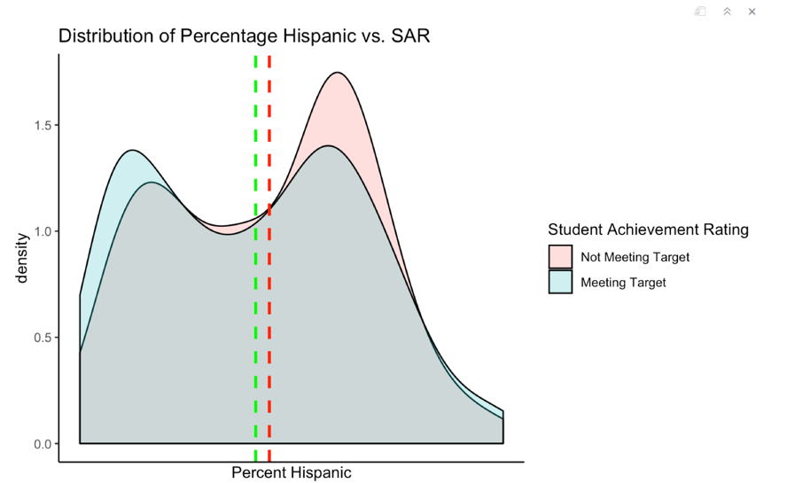
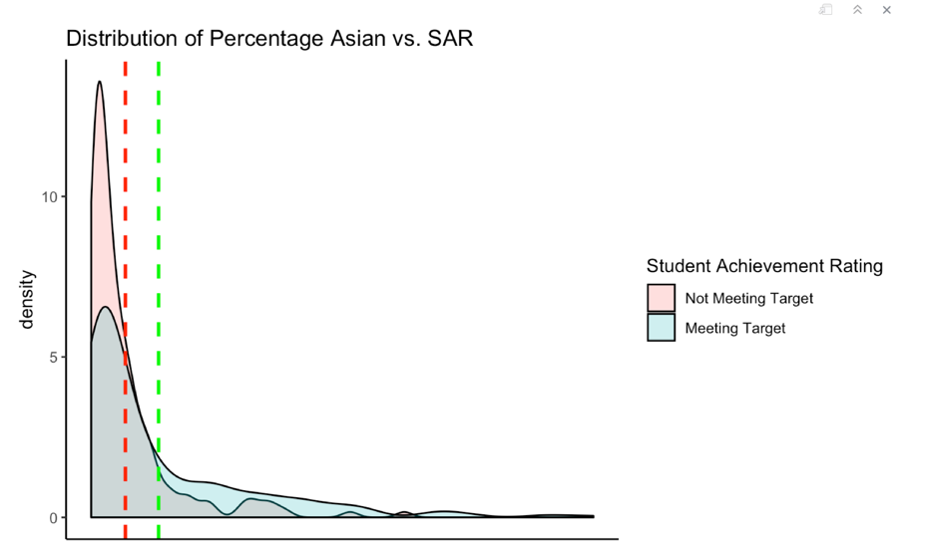
Race Predictors
Percent White
Percent Black
Percent Hispanic
Percent Asian

Slide 12
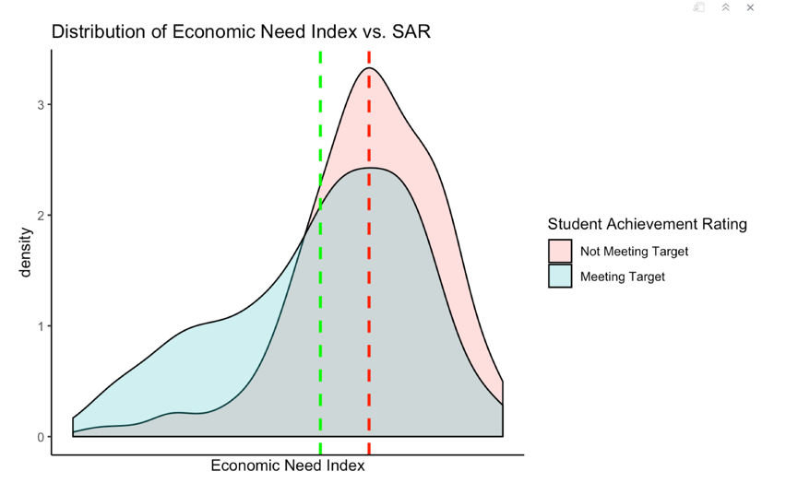
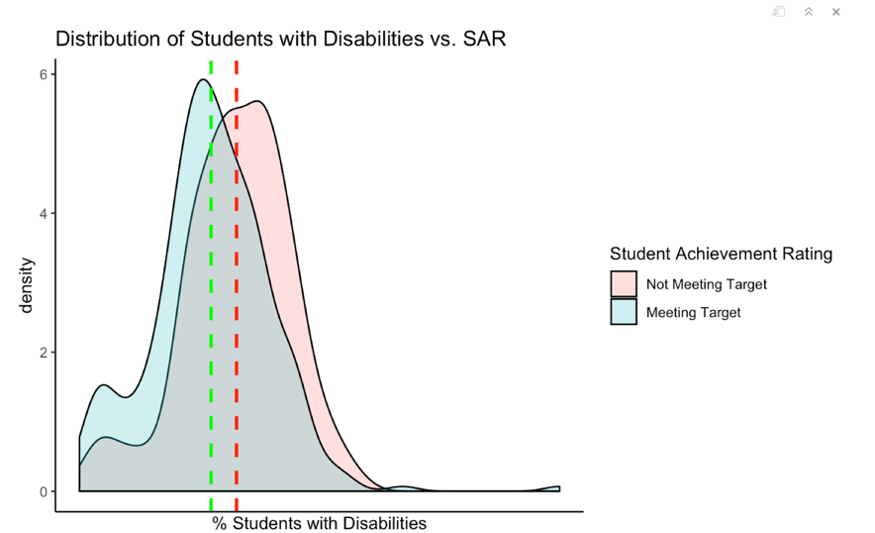
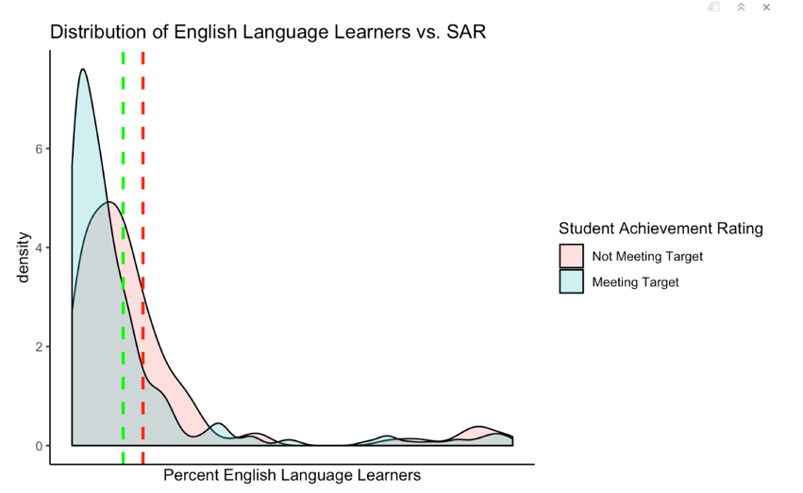
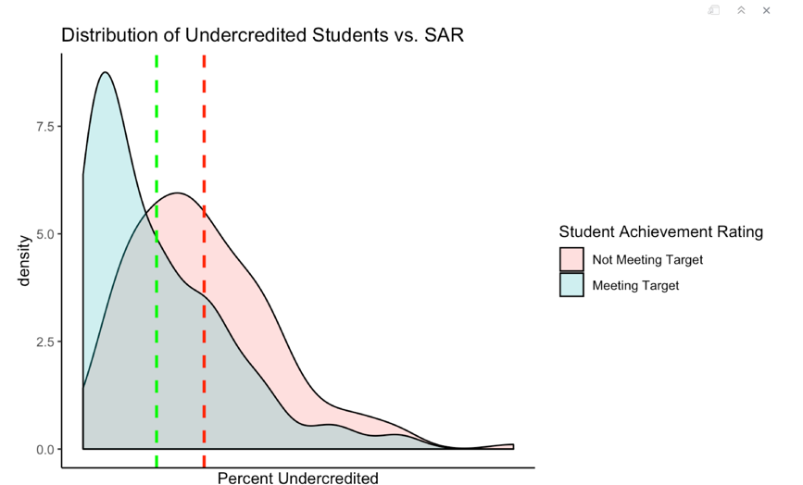
Student Composition Predictors
Economic Need Index
% Students w/ Disabilities
% English Language Learners
% Students Undercredited

Slide 13
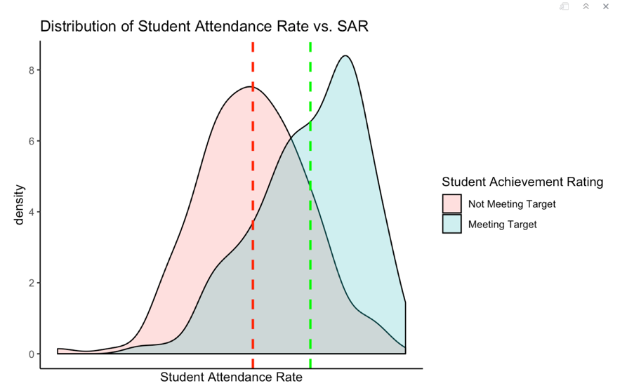
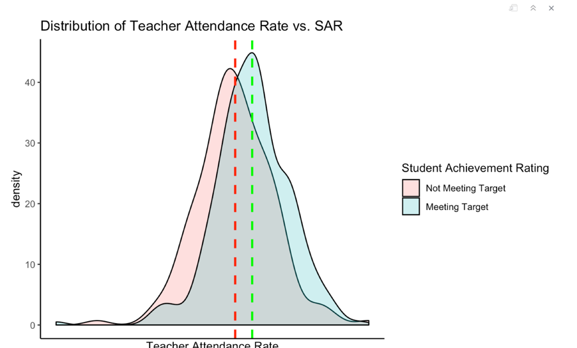
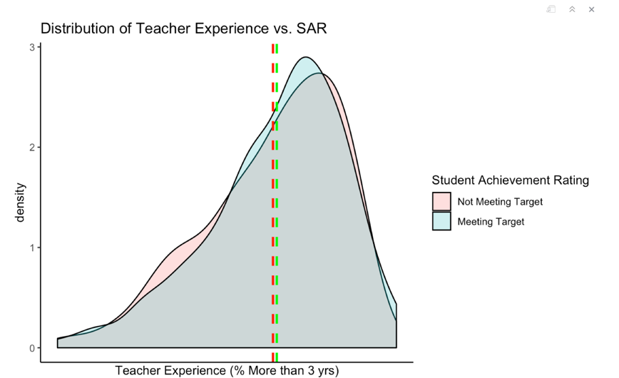
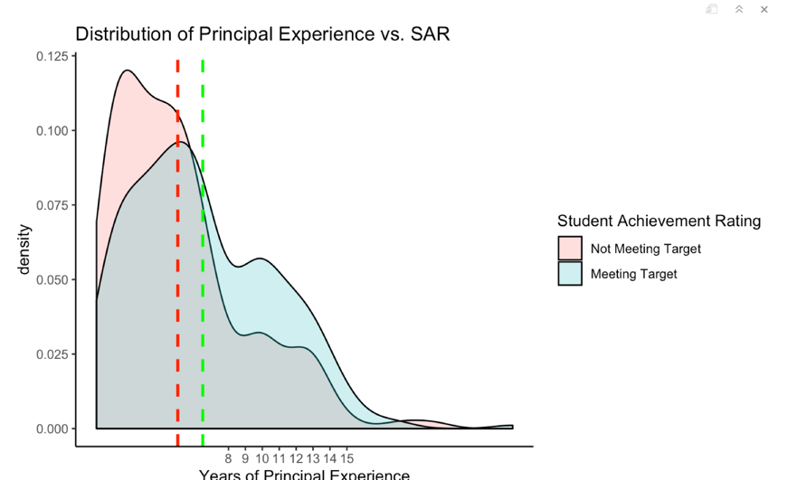
School-Specific Predictors
Student Attendance Rate
Teacher Attendance Rate
Teacher Experience
Principal Experience

Slide 14
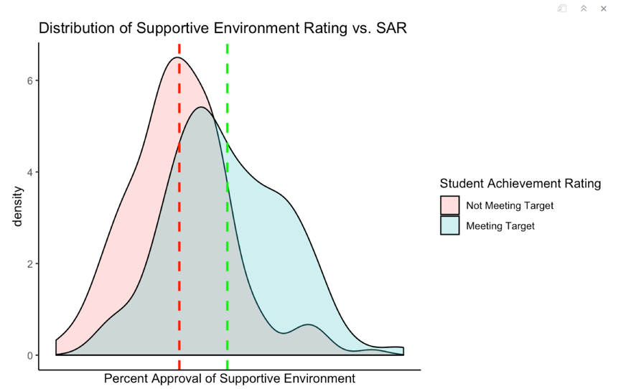
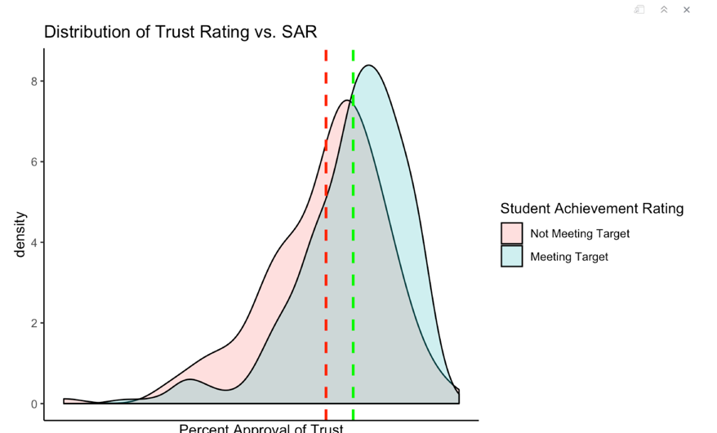
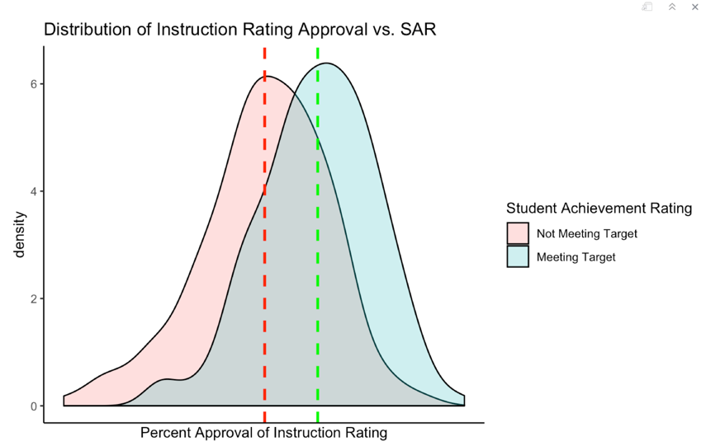
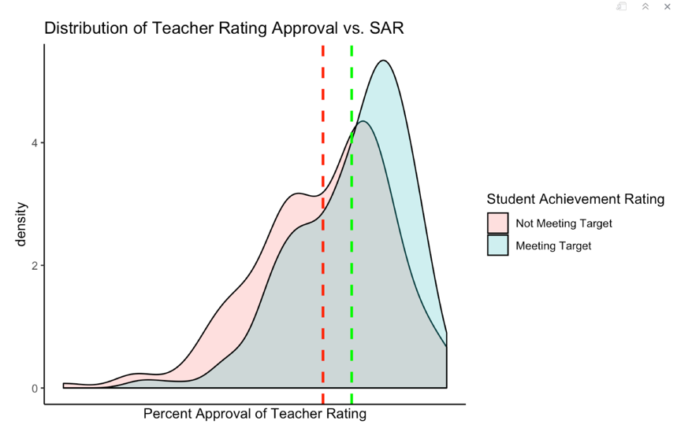
Subjective rating metrics
Supportive Environment
Teacher Attendance Rate
Curriculum Rigor
Teacher Rating

Slide 15

Modeling

Slide 16
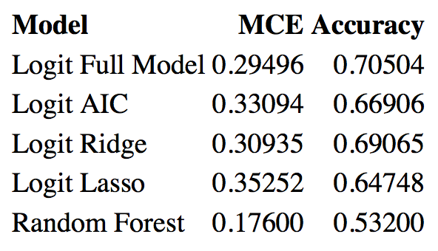
Model Selection
Tried Ordinary Logit, Ridge, Lasso, and Random Forest
Accuracy highest for ordinary logistic
Sacrificed 1% prediction accuracy to address high p-values and collinearity

Slide 17
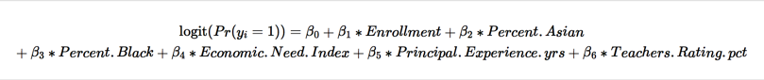
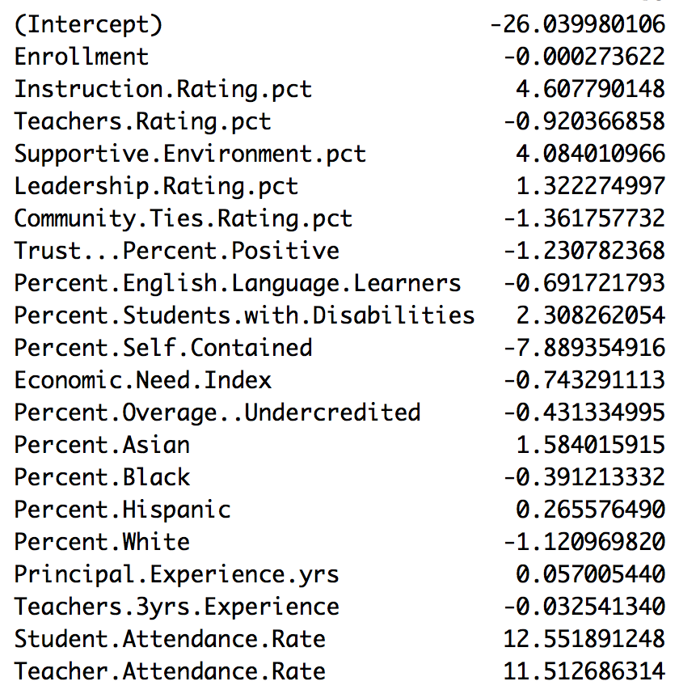
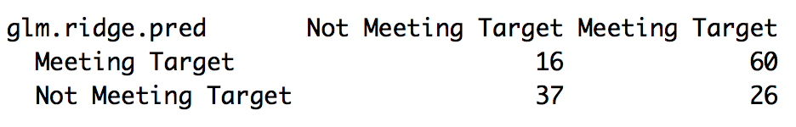
Ridge Regression Model Specification

Slide 18

Shiny Visualizations
http://127.0.0.1:3419

Slide 19
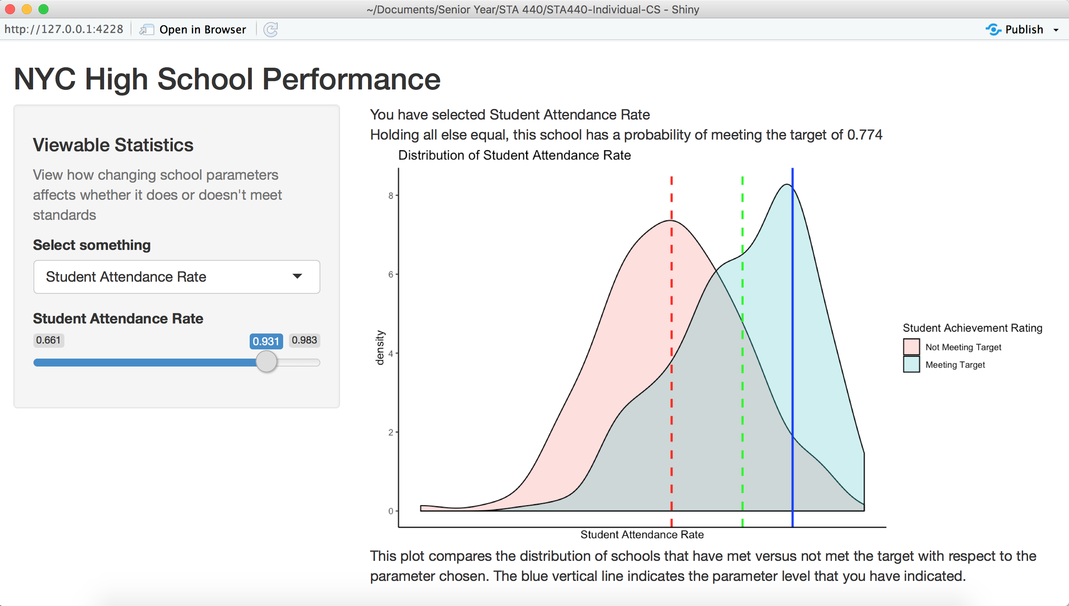

Slide 21

Conclusions

Slide 22
Conclusions that made sense
Variable | Effect
School Size
English Language Learners
Economic Need Index
Self-Contained Classrooms
Attendance Rate (Students and Teachers)
Instruction Quality
Supportive Environment
Principal Years Experience
From the magnitude of the coefficients, Attendance Rate and Instruction Quality have the highest directional impacts on educational quality.
Policy makers should focus on incentivizing attendance rate and building more rigorous curriculum

Slide 23
Conclusions that surprised me
Variable | Effects
Teacher Approval Rating
Trust Rating
% Teachers with >3 years experience
Community Ties Rating
Students approve of easier teachers that don’t prepare them well?
My mother has famously low student approval, but sees high # of students being CPA certified

Slide 24
Conclusions that surprised me
Variable | Effects
Teacher Approval Rating
Trust Rating
% Teachers with >3 years experience
Community Ties Rating
Students who trust each other too much aren’t competitive enough?

Slide 25
Conclusions that surprised me
Variable | Effects
Teacher Approval Rating
Trust Rating
% Teachers with >3 years experience
Community Ties Rating
Teachers are getting outdated in their educational ways?

Slide 26
Conclusions that surprised me
Variable | Effects
Teacher Approval Rating
Trust Rating
% Teachers with >3 years experience
Community Ties Rating
School vs. Community conflict of interests
Parents in my school district kept pestering schools to lower stress, which led them to dumb down the curriculum

Slide 27
Next Steps

Slide 28
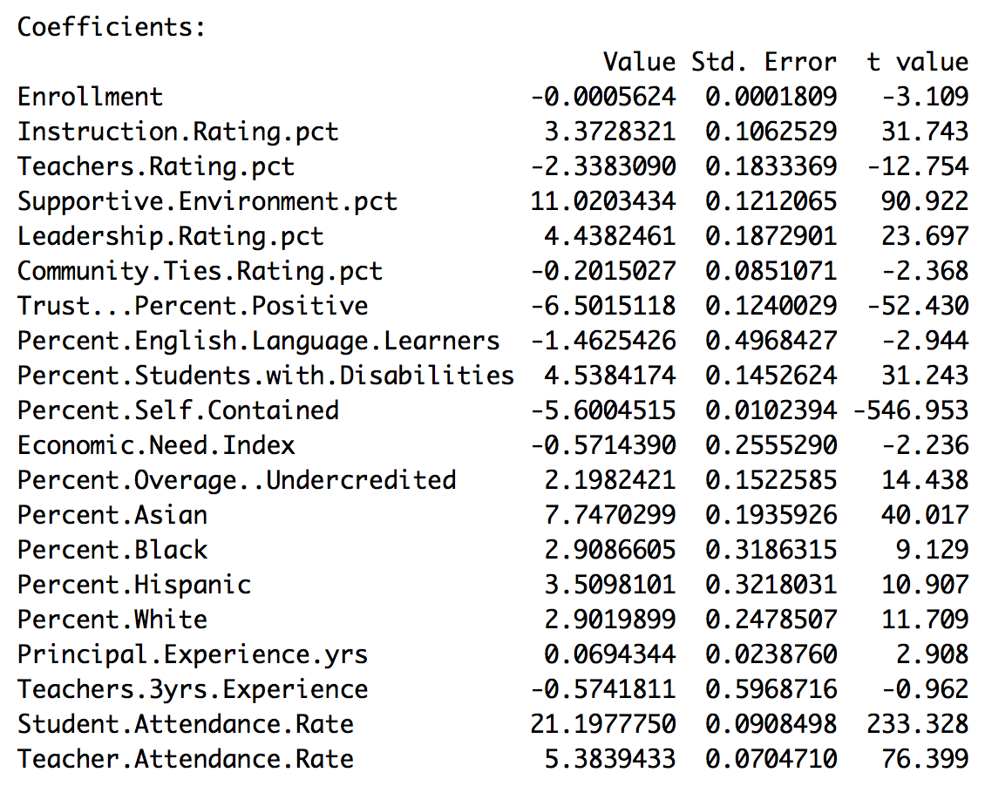
Next Steps
Explore Proportional Odds/Multinomial Logistic Regression to allow for modeling for all our original student achievement categories

Slide 29
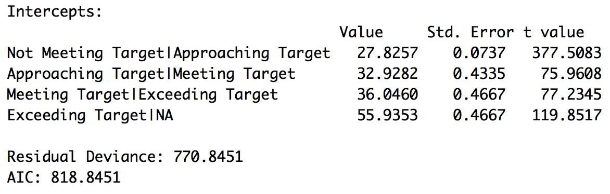
Next Steps
Relative risk across four levels much more difficult to interpret

Slide 30
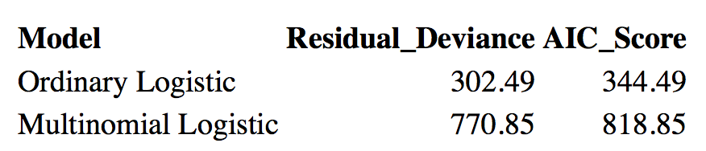
Next Steps
“Not Meeting Target” only has 39 occurrences, which inflates residual deviance and hurts AIC
Wanted to use penalized likelihood estimation to handle sparse events categories, but unfortunately “pmlr” package is no longer available on R

